Slide 1
Project: Predict Future Sales
DS636002
Group Members
Gagan Indukala Krishna Murthy
Aanwi Anil Tarihalkar
Shataksh

Slide 2
Introduction
In this project, we have aimed to predict future sales leveraging machine learning techniques on a comprehensive dataset of historical sales transactions. Our primary objective was to develop a model that can forecast sales trends, aiding businesses in making informed decisions regarding inventory management and resource allocation. To achieve this, we began by cleaning and preprocessing the dataset, addressing missing values, and merging relevant data sources such as item categories and shop information. Through exploratory data analysis (EDA), we uncovered insightful patterns and relationships within the data, providing a foundational understanding for subsequent modeling. We opted for the Random Forest algorithm, known for its effectiveness in handling time-series data, to train our predictive model. Evaluation using the Root Mean Squared Error (RMSE) metric validated our model's accuracy and reliability. The resulting model successfully generated predictions for future sales, empowering businesses with actionable insights for optimizing operations.

Slide 3

Dataset
We have used the Predict Future Sales Dataset from
File descriptions
sales_train.csv - the training set. Daily historical data from January 2013 to Oct 15.
test.csv - the test set. Need to forecast the sales for these shops & products for Nov 15.
submission.csv - The submission file is the Final output data.
items.csv - supplemental information about the items/products.
item_categories.csv - supplemental information about the items categories.
shops.csv- supplemental information about the shops.

Slide 4
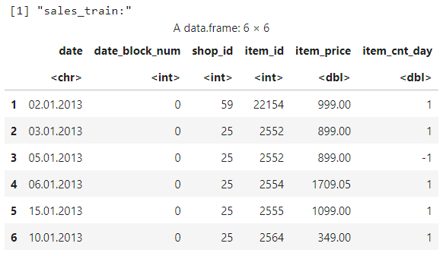
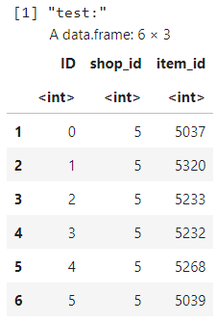
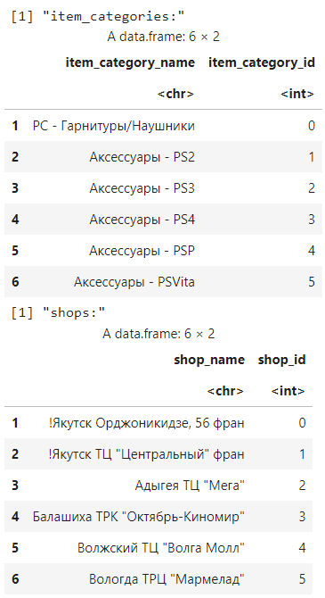
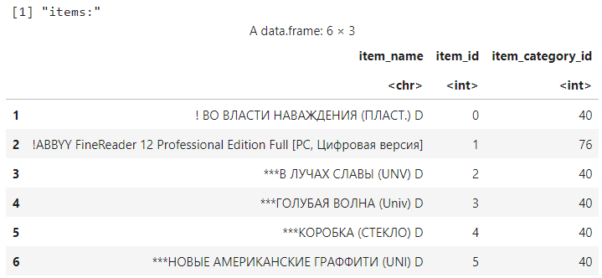
A Look into the Datasets

Slide 5
Data Visualization and Representation
making it easier to identify patterns, trends, and outliers

Slide 6
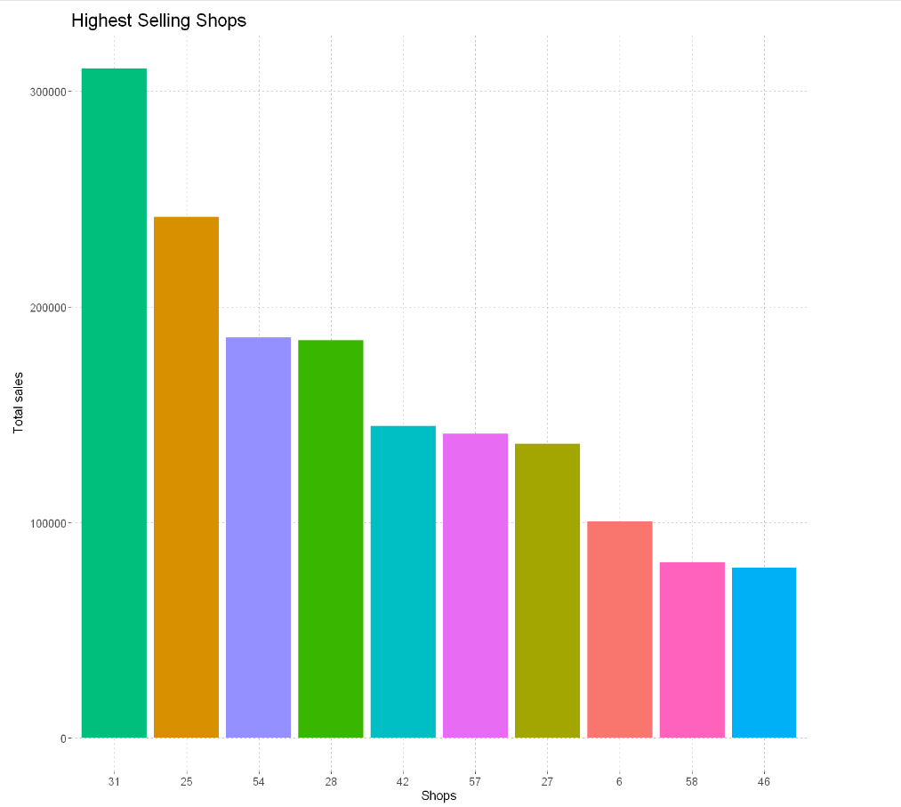
Top 10 highest selling shops

Slide 7
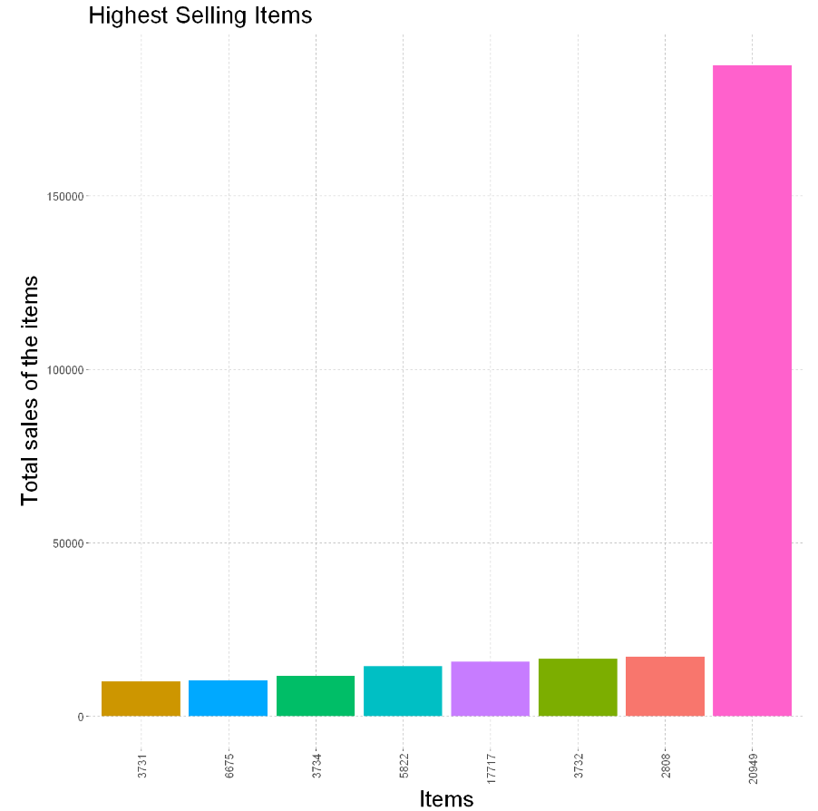
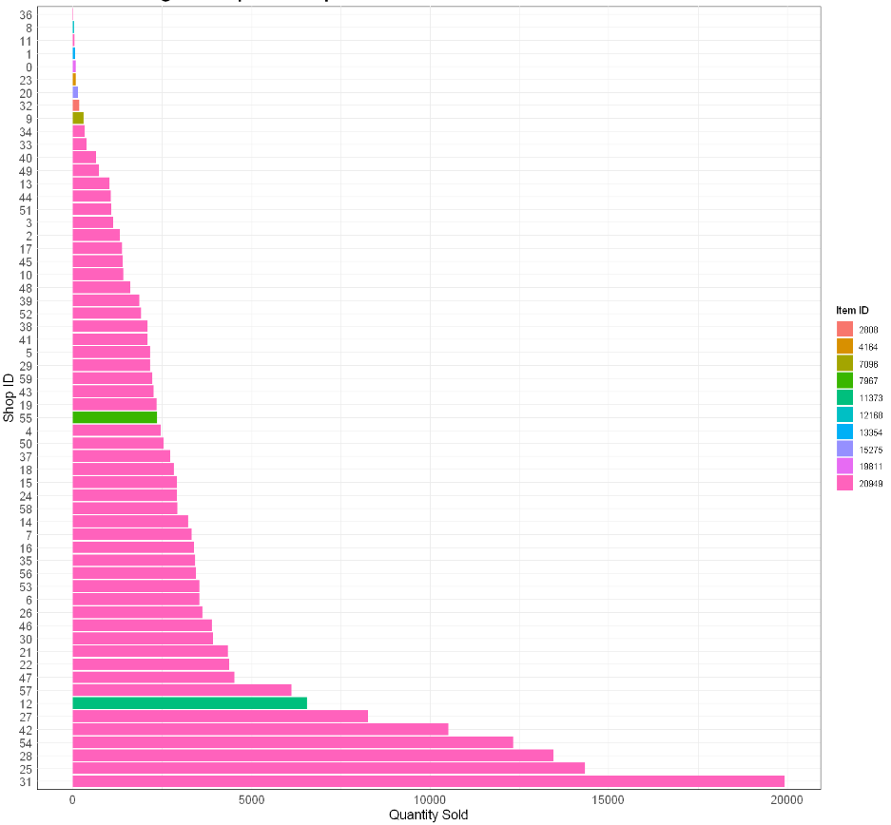
Top 10 highest selling items
Most sold item per shop

Slide 8
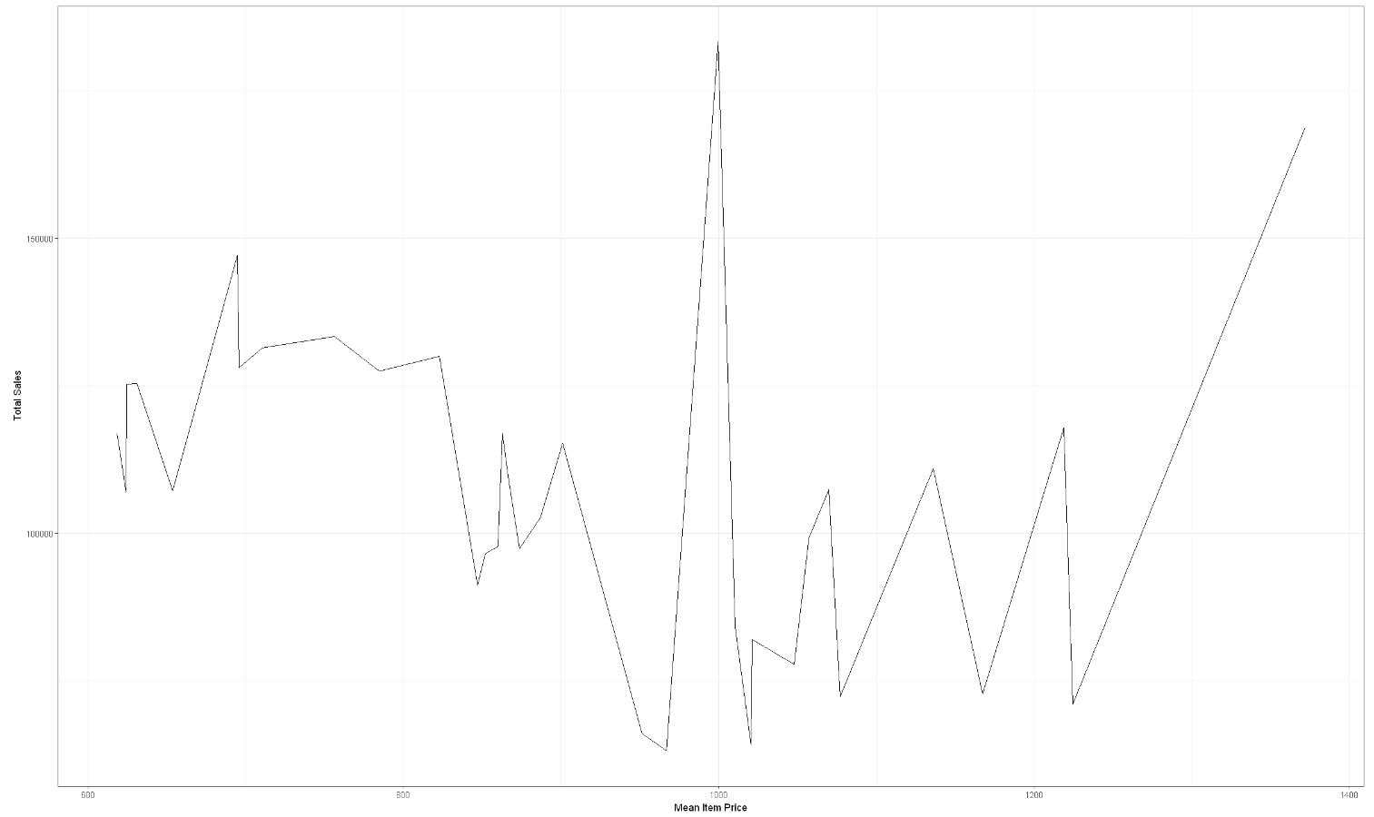
Relationship between mean item price and total sales

Slide 9
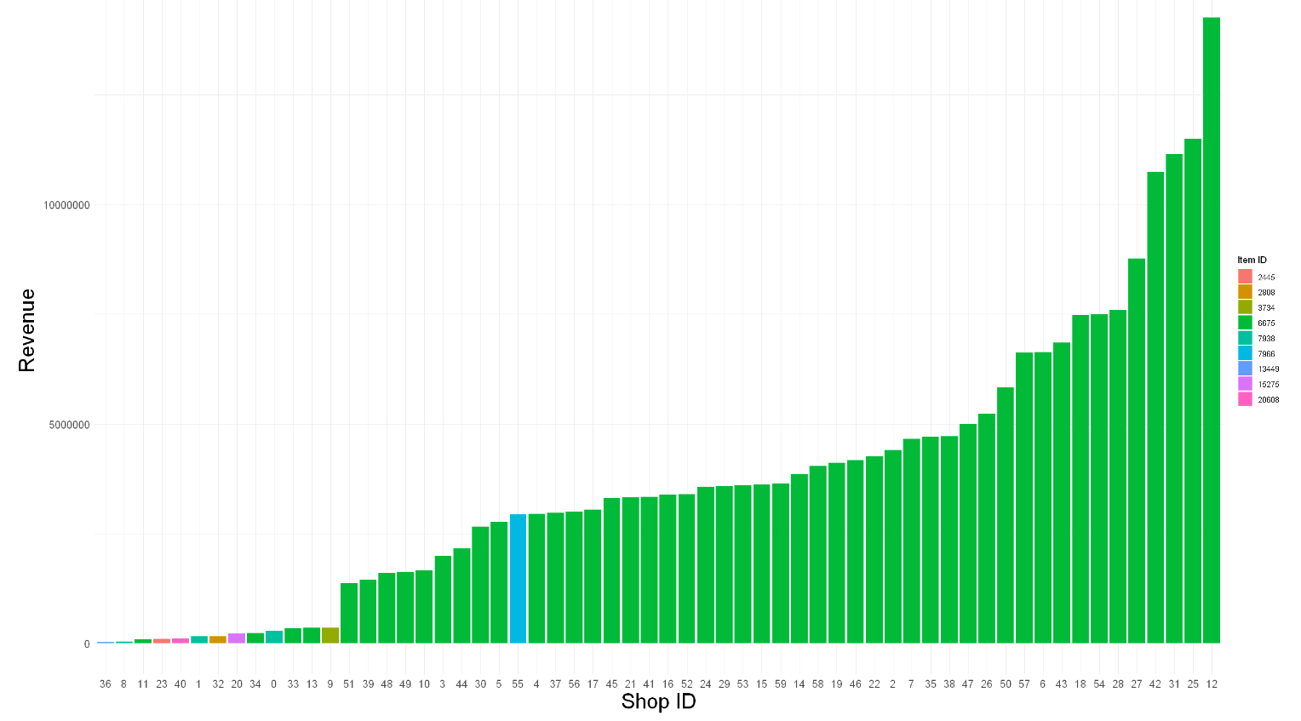
Most profiting item per shop

Slide 10
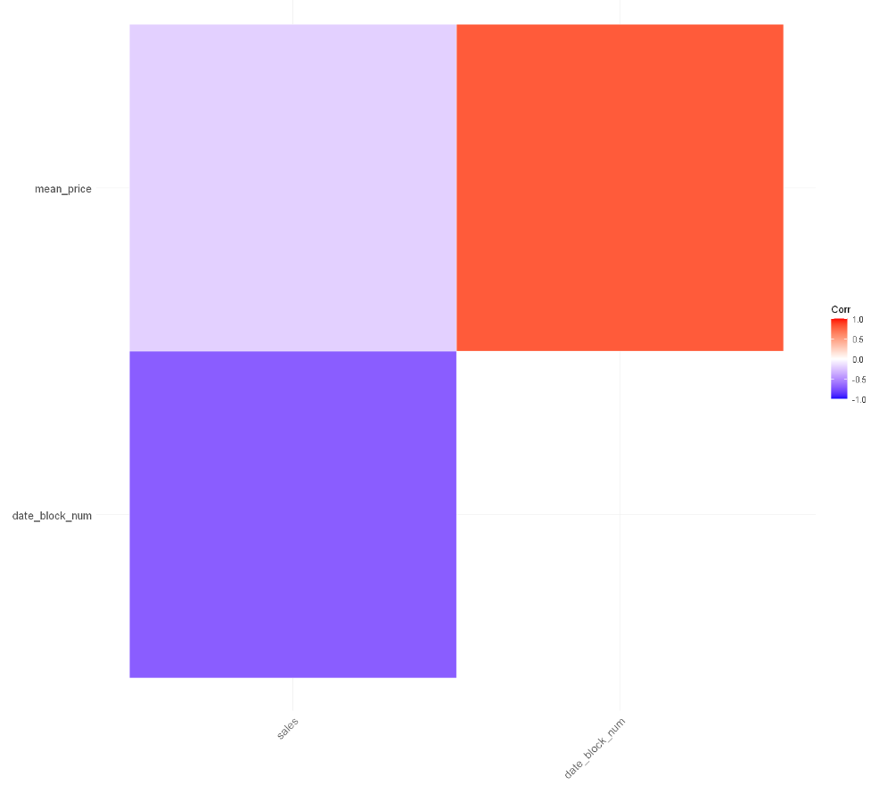
Co-relation Matrix
The negative association between date block number and sales suggests a declining trend over time, possibly due to market saturation or changing consumer preferences. Conversely, the positive association with mean price indicates increasing prices over time, influenced by inflationary pressures or pricing strategies. These trends reflect the complex dynamics of supply, demand, and market conditions within the dataset.

Slide 11
ML Algorithms: KNN and Random Forest
K-Nearest Neighbors (KNN) and Random Forest algorithms play pivotal roles in analyzing and predicting future sales based on historical data. KNN was employed for imputing missing values using the k-nearest neighbors approach, which leverages the similarity of data points to estimate missing values effectively. This technique helped enrich the dataset and prepare it for predictive modeling by incorporating historical trends and patterns. On the other hand, Random Forest was utilized for predicting future sales, leveraging its ability to handle large datasets efficiently and mitigate overfitting through ensemble learning. The Random Forest model was trained on historical sales data, considering various features derived from the dataset to generate accurate predictions for the test set. Both algorithms were evaluated using metrics like Root Mean Squared Error (RMSE) to assess their performance in predicting sales accurately. The results from these evaluations provided insights into the effectiveness of each algorithm and highlighted areas for potential improvement.

Slide 12
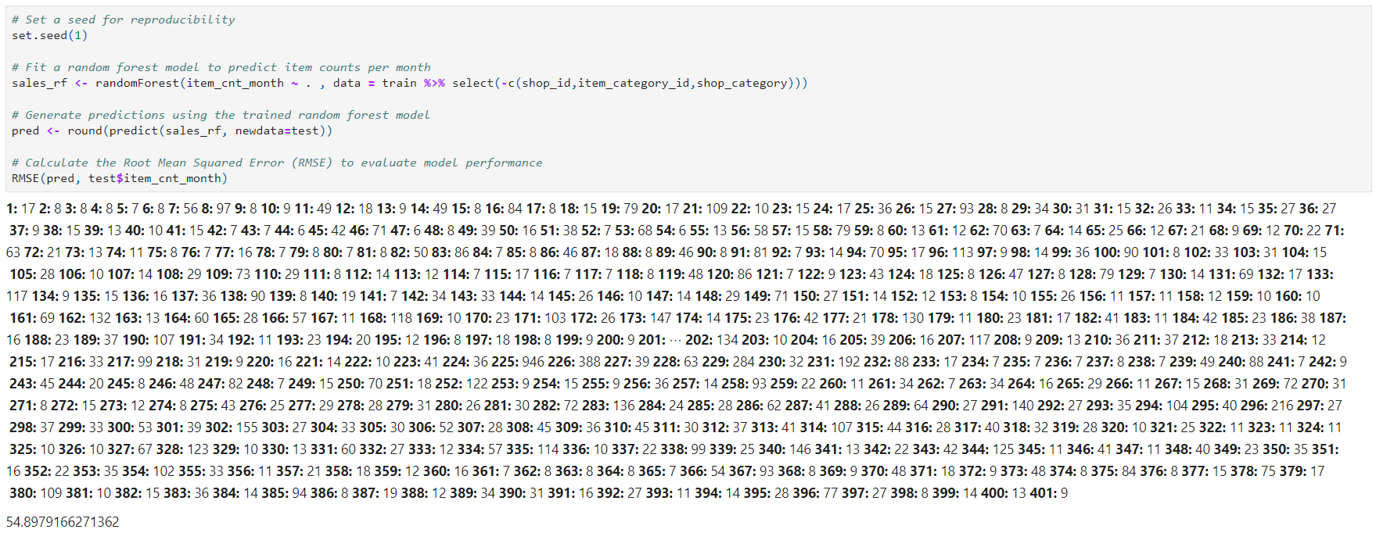
Applying RandomForest to training data

Slide 13
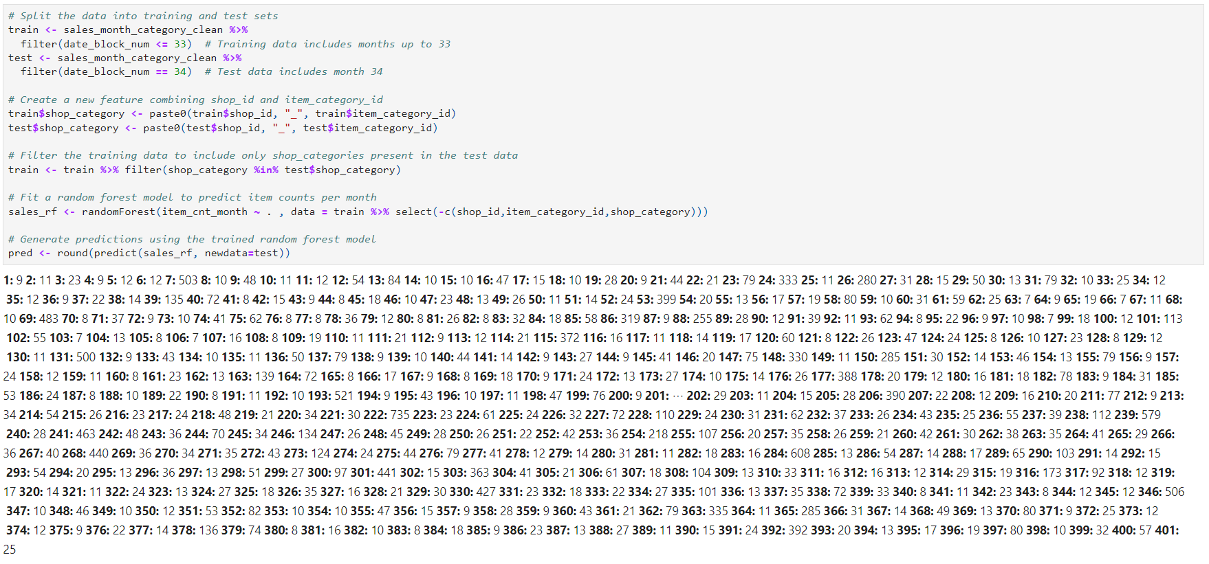
Applying RandomForest to test data

Slide 14
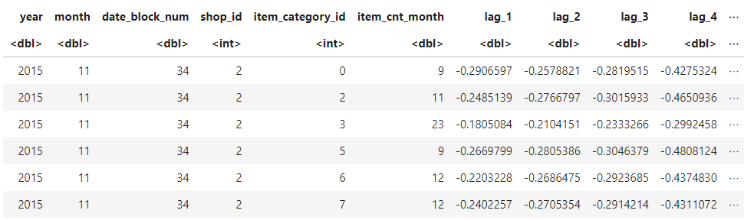
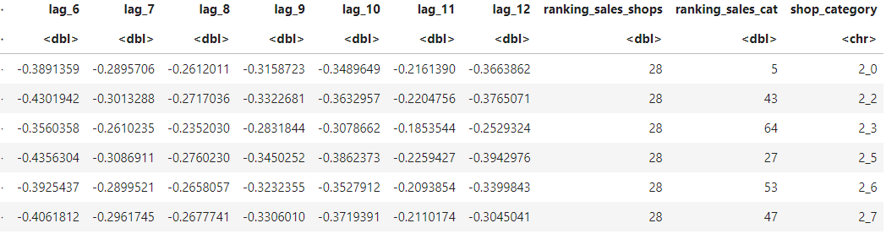
OUTPUT

Slide 15
Conclusion
In summary, this project has showcased the practical application of data preprocessing methods and ensemble learning techniques in retail analytics. By utilizing approaches like K-Nearest Neighbors (KNN) for data imputation and Random Forest for sales forecasting, the project demonstrated effective management of missing values and accurate prediction of sales trends. The evaluation using Root Mean Squared Error (RMSE) validated the predictive models' performance, highlighting their reliability for decision-making. This study underscores the value of machine learning in extracting actionable insights from retail data, aiding in strategic decision-making and operational efficiency. Looking ahead, further exploration into feature engineering and model refinement could enhance predictive capabilities, ultimately driving business competitiveness and efficiency in the retail sector.

Slide 16




Contribution of Group Members
Gagan: R Programing Scripts for the Project
Aanwi: Documentation, PPT and Presentation
Shataksh: Presentation
Shataksh
Gagan
Aanwi

Slide 17


